Slide 1
Category review: Chips
Aswathi Ajith
December 12, 2024
Retail Analytics
Brand note: If client logo is not required, use alternate title page layout right click slide thumbnail > Layout > Title

Slide 2
Notes:
To view Privacy video explaining how important data privacy is to Quantium, please click here: https://www.youtube.com/watch?v=Zq1QDAkoRzU
or here Q:\Company Reference\Brand & Design\Brand videos\Q Privacy.mp4
At Quantium, we believe that data is the behavioural footprint of humanity and that it has to be treated with the utmost care and responsibility.
Histories, attitudes, indeed lives are stored within it in ways that aren’t always apparent – and that’s what makes its potential so powerful.
To work with it responsibly, sensitively, we set ourselves the highest data privacy protection and governance standards.
We have spent 17 years perfecting privacy-by-design and secure-by-design principles. Central to this is not holding any personally identifiable information about people –
we neither receive it, and put the necessary protections in place to be unable to decipher it.
Every aspect of handling data is safeguarded: from its de-identification, to its encryption – data security is paramount and of the highest grade.
We pride ourselves on gaining the trust of iconic organisations around the world through years of securely working with their data,
and in turn the trust that builds with their stakeholders.

Slide 3
Executive summary
The three highest-contributing segments to total chip sales are Older Families - Budget, Young Singles/Couples - Mainstream, and Retirees - Mainstream, with Kettle being the most purchased brand across all segments.
Despite not having the largest population, Older Families drive sales through their high purchase frequency and larger average quantities per purchase.
The Mainstream Young and Mid-age Singles/Couples spend significantly more per purchase, and the most popular chip sizes are 175g and 150g across all segments.
01
Task 1
02
Task 2
The Trial store 77 sales for Feb, March, and April exceeds 95% threshold of control store. Same goes to store 86 sales for all 3 trial months.
Both trial store 77 and 86 showed significant increase in Total Sales and Number of Customers during trial period. But not for trial store 88.
Overall, the trial showed positive significant result.

Slide 4
01
Category

Slide 5
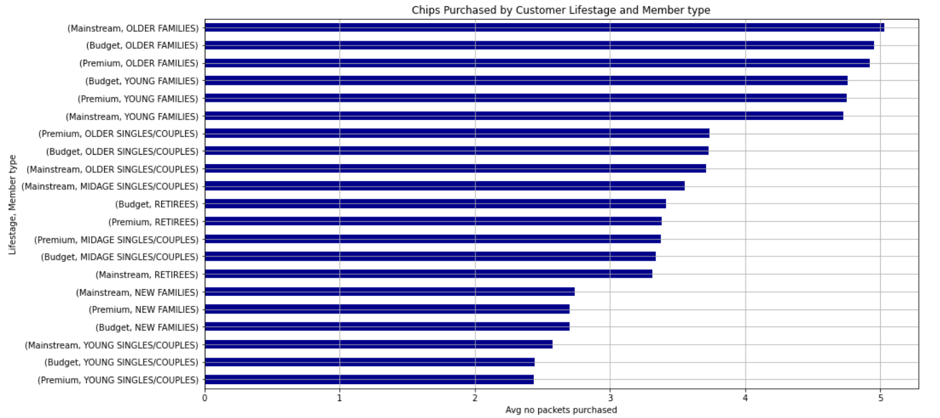
Older and Young families purchase more chips on average than other groups.

Slide 6

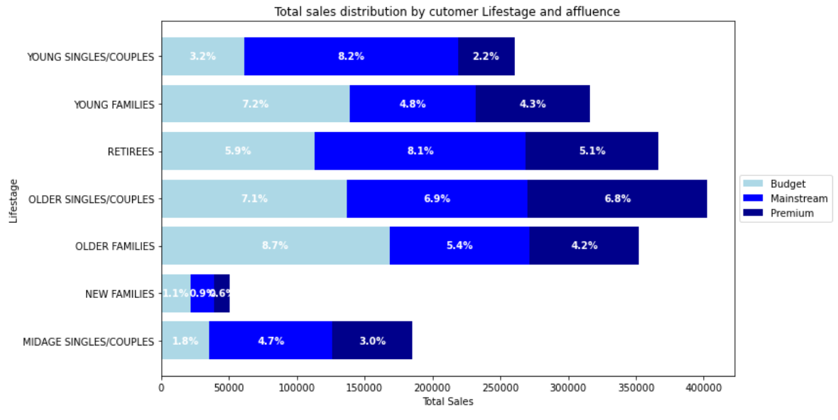
Sales are mostly coming from Budget older families and followed by Mainstream young singles/couples

Slide 7
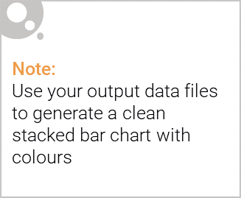
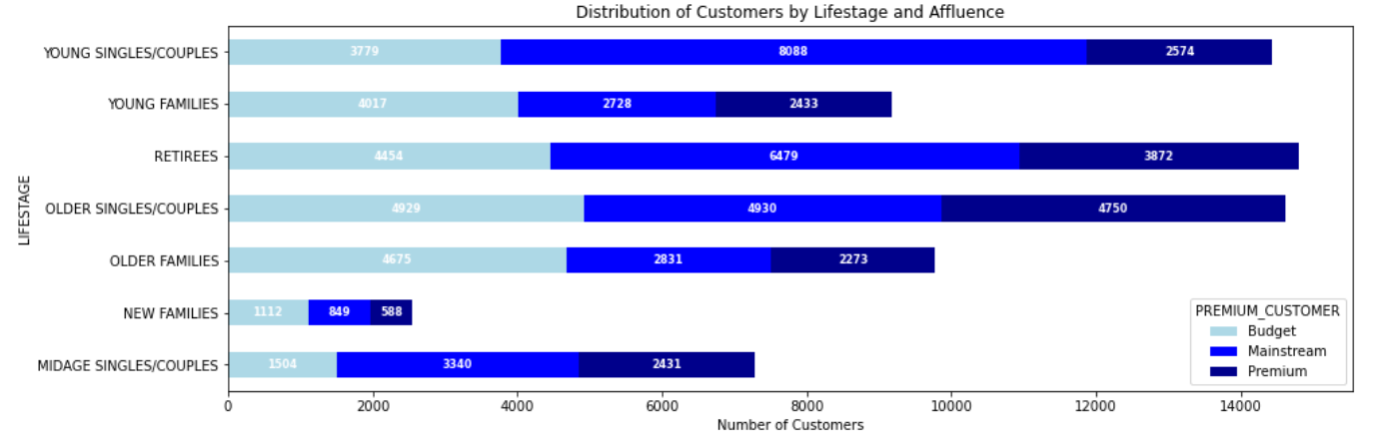
Editable (delete this)
Mainstream young singles/couples have a larger population, contributing significantly to total sales.

Slide 8
Inferences
The highest sales contributors are Older Families (Budget), Young Singles/Couples (Mainstream), and Retirees (Mainstream).
Young Singles/Couples (Mainstream) lead in population, while Older Families, despite a smaller population, drive sales through the highest purchase frequency.
Older Families and Young Families buy the largest average quantity of chips per purchase. The Mainstream Young/Mid-age Singles/Couples segment spends significantly more per purchase than their non-Mainstream counterparts.
Kettle dominates as the most purchased chip brand across all segments, with 175g being the most popular size, followed by 150g.

Slide 9
02
Trial store performance

Slide 10
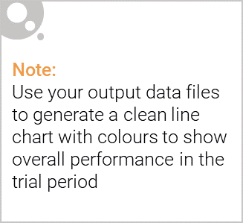
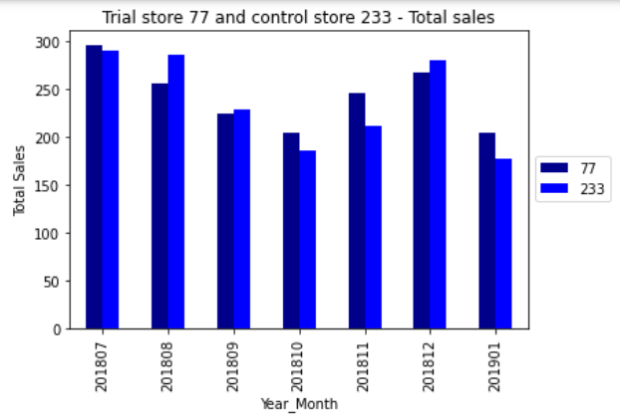
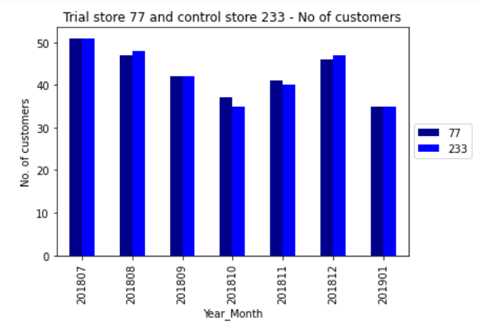
Control stores are strategically selected based on key metrics to mirror trial stores, ensuring accurate performance analysis during the trial period.
Visualized the pre-trial performance with plots comparing total sales and customer numbers for each trial-control store pair. Eg. Trial store 77 and control store 233

Slide 11
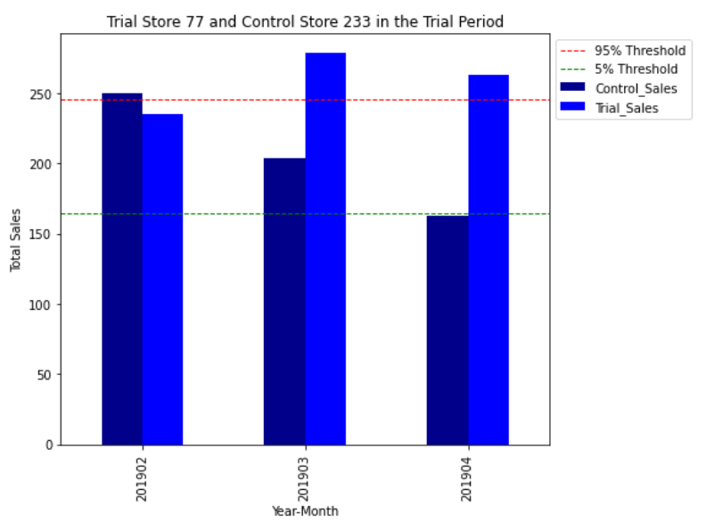
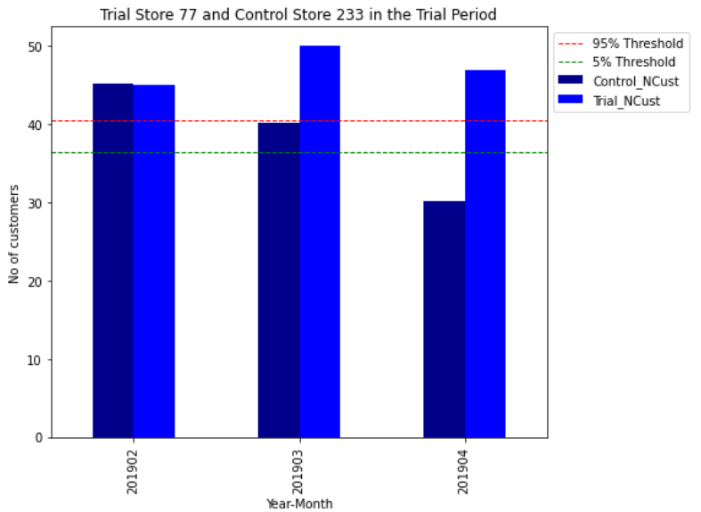
Trial store 77 and control store 233
Trial sales and No of customers consistently exceed the 95% threshold for all three months (Feb, March, and April 2019)
This indicates a significant improvement for Trial Store 77 during the trial period.

Slide 12
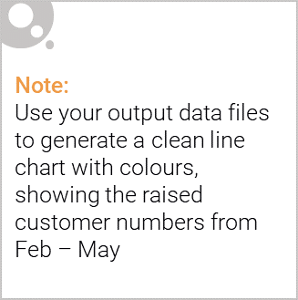
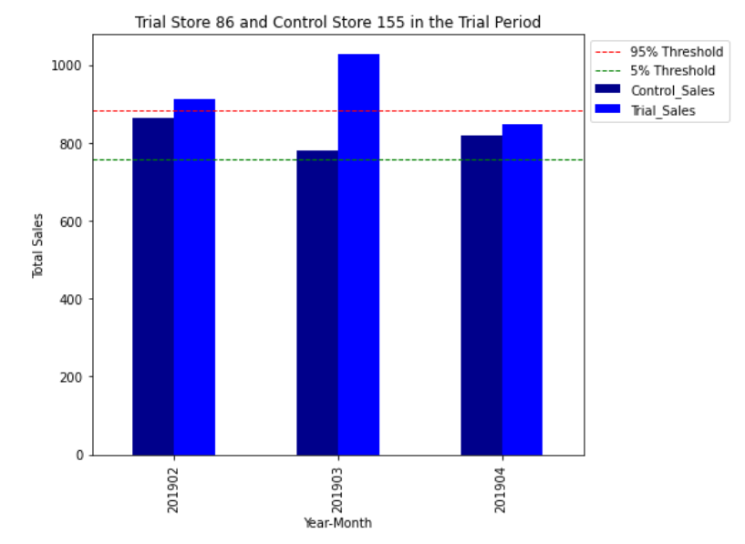
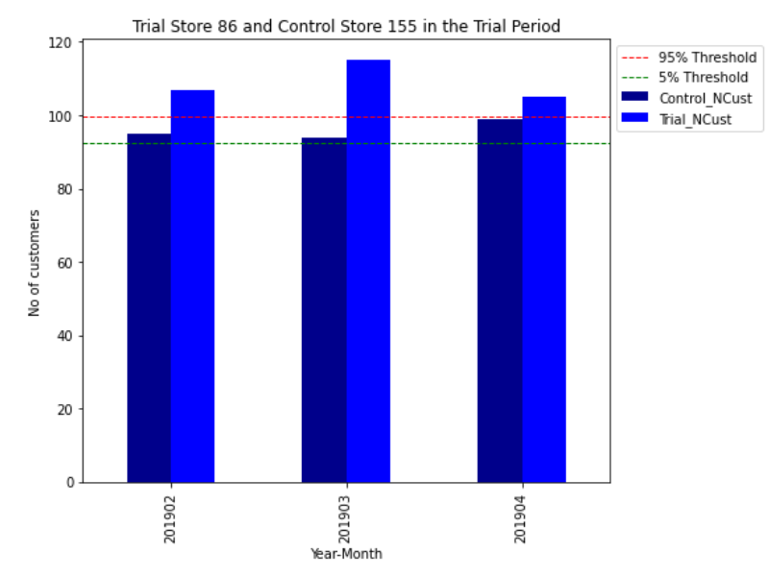
Trial store 86 and control store 155
Trial sales and No of customers consistently exceed the 95% threshold for all three months (Feb, March, and April 2019)
This indicates a significant improvement for Trial Store 86 during the trial period.

Slide 13
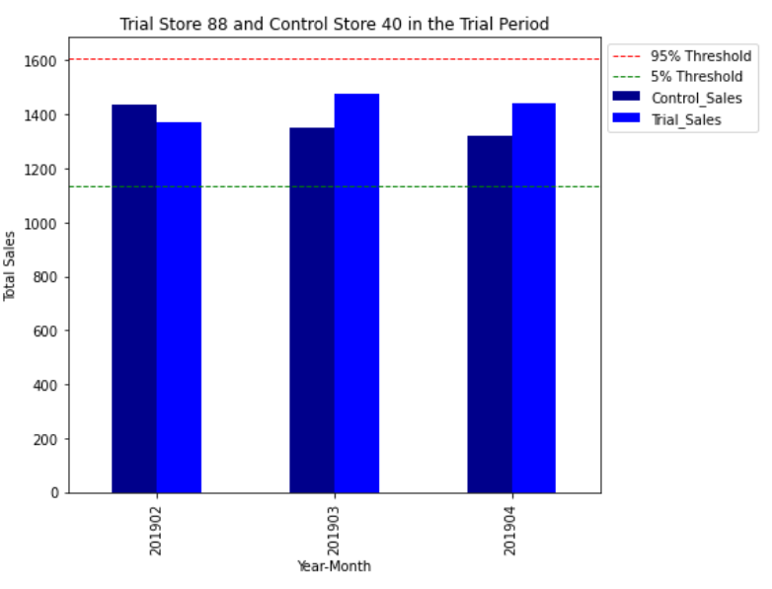
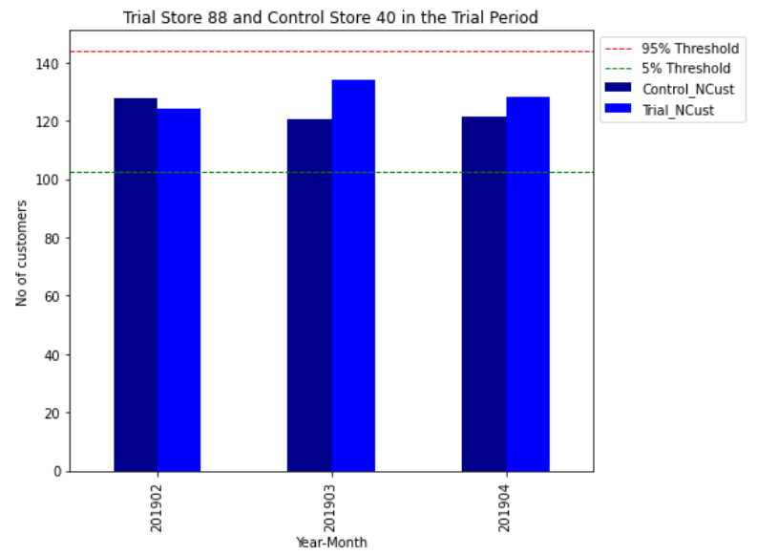
Trial store 88 and control store 40
Trial sales and No of customers for Store 88 barely exceed the 95% threshold, suggesting limited impact of the trial layout.
This indicates that there isn’t any significant improvement for the trial store during the trial period.

